Slide 1
MINERAL RESOURCES
M.A.-I

Slide 2
1. Minerals Dissolved in Seawater
salt, bromine, magnesium, gold, zinc, uranium, thorium
one cubic kilometer of seawater contains 41.25 million tonnes of solid materials in dissolved form.
Salt- 85 per cent of salt dissolved in seawater is constituted by sodium and chlorine.
1/3 of total world salt is manufactured through evaporation method.
In India – Gujarat (50 %) , Maharashtra and Tamil Nadu.
Refined Seawater is called as manufactured water.
Most demand in the coastal countries of warm arid regions due to rapid rate of urbanization.
several techniques of desalinization have been developed.
estimate 4 grams of gold in every one million tonnes of seawater.
Total Ocean-estimated 5 million tonnes.

Slide 3
2. Minerals of Sea Deposits
On the basis of sources and location minerals of sea deposits are divided into two categories viz.
Minerals of the Deposits on continental shelves and slopes
Minerals of Deep Ocean bottom deposits

Slide 4
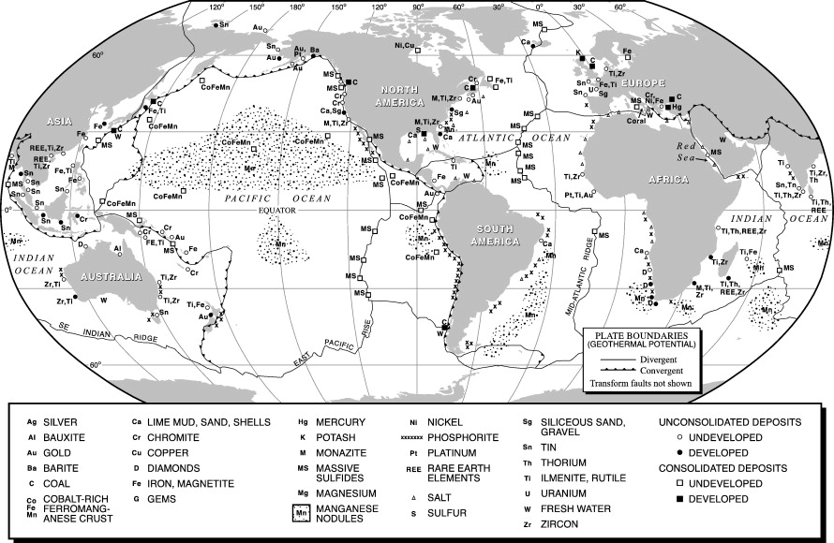

Slide 5
A) Minerals of the Deposits on continental shelves and slopes
Minerals of the Deposits on continental shelves and slopes include zircon, monazite, magnetite, gold placer, diamond, platinum, sulpher, phosphoresce and several types of building materials (like sands, grav­els, boulders etc.).
Monazite reserves are found in the coastal areas of India, United States of America, Brazil, Sri Lanka, Australia and New Zealand. India has the largest reserve of monazite of the world (90 per cent) in the placer deposits of Kerala coast.
About 29 per cent of rutile mineral of the world is found in Australian coast areas. In fact, rutile is titanium dioxide and is used for coating on welded rods.
Magnetites are associated with volcanic rocks and thus these are found in those continental shelves and slopes which are characterized by valucanicity. Magnetites are, thus, found along the circum-Pacific volcanic belt i.e. along the western coastal areas of North and South America and eastern coasts of Asia. Japan coastal areas are estimated to have a magnetite reserve of 36 million tonnes.
Cassiterite is a type of tin which is separated due to weathering of granites. Maximum reserves of cassitierites are found in the coastal areas of Thailand, Malasia and Indonesia.
Gold deposits are found in the continental shelves of Alaska and Oregon (USA), Chile, South Africa and Australia but its extraction is commercially not beneficial because of extraction cost.
Phosphorites are mixed with muds and sands of continental shelves and slopes and are found in nodule form. Phosphorites are used for the manufacturing of fertilizers. Their estimated world reserves are 50 million tonnes, which are found in the continental shelves of Mexico, Peru, Australia, Japan and South Africa and their extraction at commercial level has yet to be started.

Slide 6
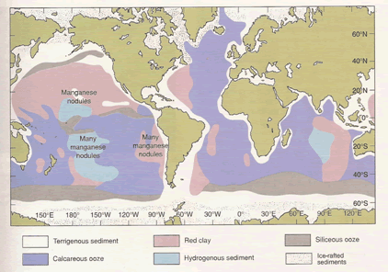
B) Minerals of Deep Ocean bottom deposits
1) Manganese nodules
Manganese nodules are the most significant miner­als to be found in the ocean bottom deposits. manganese nodules upto the depth of 4000 m. It may be pointed out that manganese nodules comprise several minerals like nickel, copper, cobalt, lead, zinc, iron, silicon but there is maximum percentage of iron and manganese. Blake plateau is the second largest area of manganese nodules. These are derived through two most prevalent techniques e.g. (i) air lift technique, and (ii) continuous bucket line system. Commer­cial mining of manganese nodules has not devel­oped because of very high mining cost. Fig. 17.2 depicts world distribution of manganese nodules up to the depth of 4000 m. It may be pointed out that manganese nodules comprise several minerals like nickel, copper, cobalt, lead, zinc, iron, silicon but there is maximum percentage of iron and manganese. Blake plateau is the second largest area of manganese nodules. These are derived through two most prevalent techniques e.g. (i) air lift technique, and (ii) continuous bucket line system. Commer­cial mining of manganese nodules has not devel­oped because of very high mining cost. Fig. 17.2 depicts world distribution of manganese nodules.

Slide 7
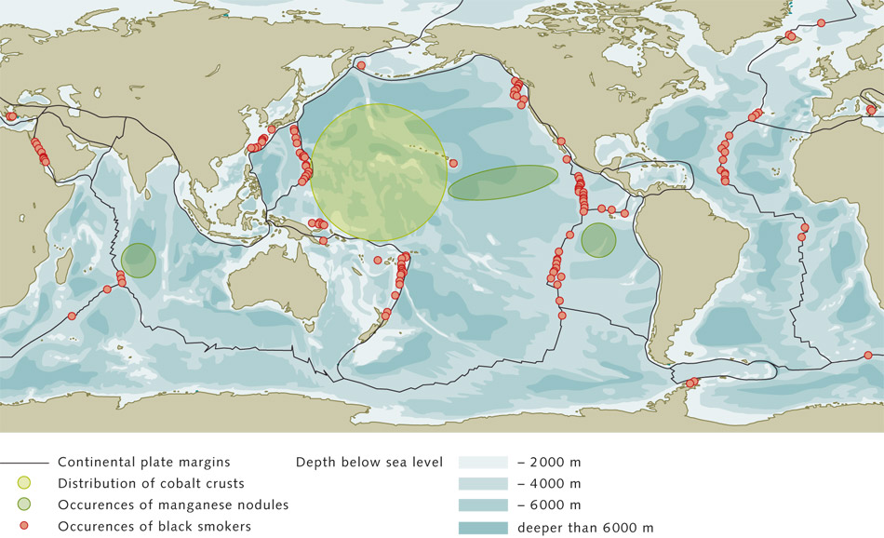
(2) Cobalt
Cobalt is a strategic mineral because of its use in military aircrafts (jet fighter planes) mainly in manufacturing aircraft engines, and in other industries. Cobalt-rich marine deposits have been discovered to be associated with seamounts, guyots and some islands. There is very rich cobalt deposit in the territorial sea and exclusive economic zone around Hawaiian Islands in the Pacific Ocean. Seamounts in the Pacific Ocean carry large deposits of cobalt as each seamount is expected to have 3 to 4 billion metric tones of cobalt ore. economic zone around Hawaiian Islands in the Pacific Ocean. Seamounts in the Pacific Ocean carry large deposits of cobalt as each seamount is expected to have 3 to 4 billion metric tones of cobalt ore.

Slide 8
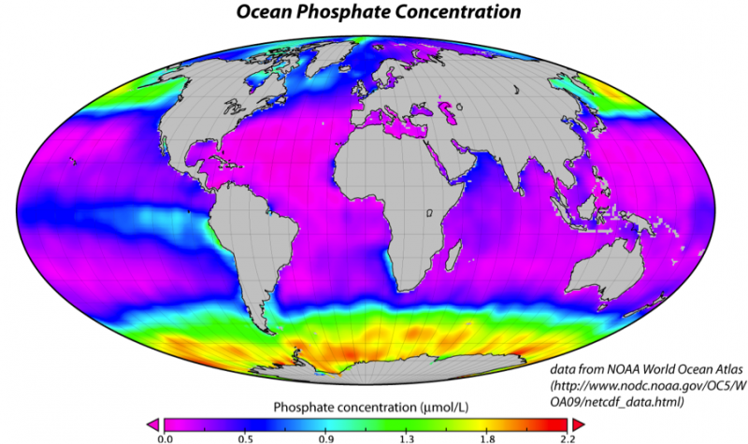
3) Phosphate
Since phosphate is the result of organic matter, it is customary to believe that phosphates would be abundantly found in those areas of the oceans where biological activities are very high. Thus, phosphates are found in the shallow water zone of continental shelves and other offshore regions where depth of seawater does not exceed 1000 meters. The coastal waters of upwelling zone accounts for large deposits of phosphates. It may be mentioned that phosphate is very essential element as it is required by both plants and animals including man. Phosphate rocks are also found on land areas and are extensively used for manufacturing phosphate fertilizers. Phosphate, are generally found in the form of phosphoritic nodules on shallow seabeds.
There are three important areas of marine phosphate:
off the coast of Morocco
off the coast of southern California (USA)
off the coast of Carolinas (USA)
small deposits around Nausu Island (small­est independent nation, area of the country = 5000 acres) in the Pacific Ocean

Slide 9
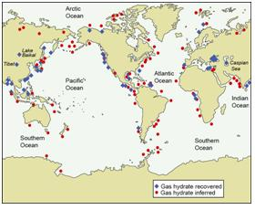
C) Hydrocarbons
The subsurface minerals (hydrocarbons) are mostly found in the oceanic crusts of continental shelves and include gas hydrates, petroleum (mineral oil) and natural gas.
(1) Gas Hydrates
Gas hydrates having methane (CHU) are white deposits of solid and frozen water mol­ecules and are found along the fissures on seabeds at the depth ranging from 300 to 500 meters in continental margins. Large deposits of gas hy­drates have been discovered in the sediments of the Arctic Ocean, Mexican Gulf, continental margins of N and S Carolinas (USA), Japan etc. Recently, large deposits of gas hydrates have been discovered in the Gulf of Mexico and it is estimated that if this vast reserve of gas hydrates is fully exploited and energy is produced through appropriate technologies, which, may enable man to get fuel energy from gas hydrates. It may be mentioned that the processing of gas hydrates for energy purposes may also release unwanted polluting gases as is the case of combustion of present hydrocarbons (mineral oil ami natural gas Thus, while developing technologies for process­ing gas hydrates, care should also be taken to tame any pollutants coming out of the process of transformation of gas hydrates into energy.

Slide 10
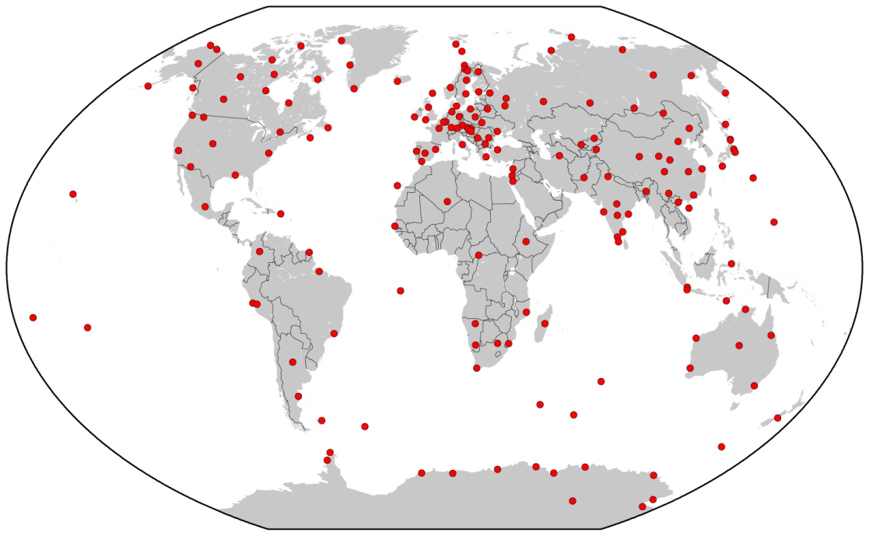
(2) Mineral Oil and Natural Gas
Subsurface minerals are mostly found in the oceanic crusts of continental shelves and include mineral oil and natural gas. Many countries have already started commercial production of petro­leum and natural gas. As regards the developed marine mineral resources, mineral oil and natural gas are the most developed marine mineral resources. There is great possibility of their expansion and development in future. Mineral oil and natural gas together contribute 90 per cent of all marine mineral resources. Offshore oil fields have been developed in the continental shelves of Mexican gulf, Persia gulf, North Sea, Norm Alaska, Mexico, South Californian coast, Arctic Sea, India, Brazil, Australia, Taiwan, Japan etc. Besides, offshore oilfields are being developed in Indonesia, east Africa, norm-west Africa, Tasma­nia, east Asia etc.
Reserves of offshore mineral oil have been explored in the offshore regions of Konkan coast (Maharashtra), Gujarat coast, Malabar and Coromandal coasts, Krishna-Cauvery delta coast, Sundarban etc. From the standpoint of produc­tion, three offshore oil fields of India are most significant e.g. Bombay High, Bassein and Aliabet, Bombay (Mumbai) High offshore oil fields are located 176 km north-west of Mumbai and are spread over an area of 2,500 square kilometres. The estimated oil reserve is 200,000,000 tonnes. Production started in 1976 and oil is drilled from the depth of 1400 m. Bassein offshore oilfields are located to the south of Mumbai High, the production of which may be more man Mumbai High oilfields if fully developed. Aliabet offshore oilfields are located 45 km away from B havnagar in the Gulf of Khambat.

Slide 11
Thank You

